Slide 1
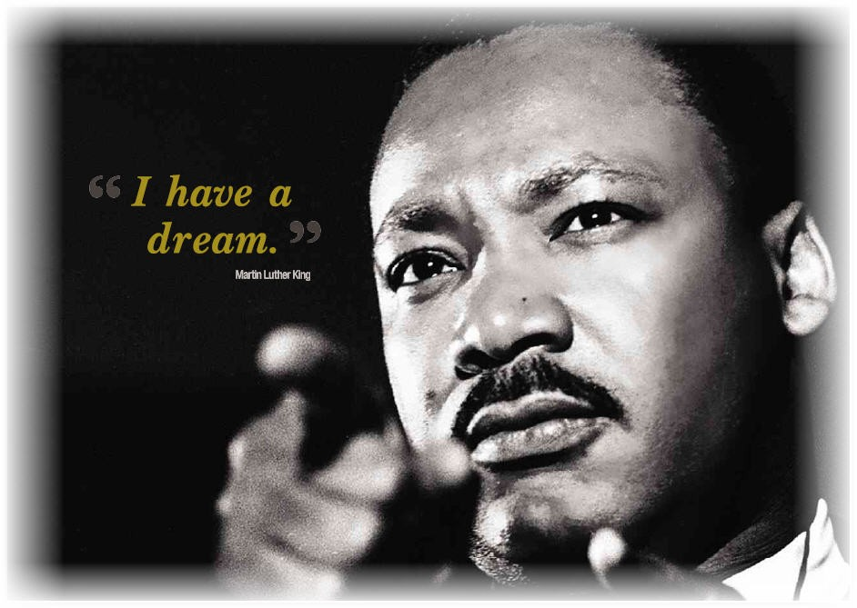
“I have a dream”
Nehemiah’s dream was much bigger than literal walls around an earthly Jerusalem
Notes:
N had cast a vision about literal walls around an earthly Jerusalem. But his dream was much bigger than that. Listen to what happened when the “baddies” showed up:

Slide 2
Nehemiah’s Opposition
¹⁹ But when Sanballat the Horonite, Tobiah the Ammonite official and Geshem the Arab heard about it, they mocked and ridiculed us. ‘What is this you are doing?’ they asked. ‘Are you rebelling against the king?’ ²⁰ I answered them by saying, ‘The God of heaven will give us success. We his servants will start rebuilding, but as for you, you have no share in Jerusalem or any claim or historic right to it.’
How did Nehemiah respond to this opposition?
He remembered God’s promises and this gave him confidence
He saw beyond the rubble to a city rebuilt for the glory of God
We must do the same.
Notes:
¹⁹ But when Sanballat …
How did Nehemiah respond?
N remembered … He remembered God’s promise that the throne of the house of David would be established forever.
He saw beyond the rubble to a city rebuilt for the glory of God.
We must do the same. As we focus on preparing our new church home in 2020, we must continually remind ourselves what we are all about as a church.

Slide 3
The Church
“The church is God’s worshipping and witnessing people, chosen by Him to live and tell the Good News about Jesus.”
“Our task as image-bearing, God-loving, Christ-shaped, Spirit-filled Christians, following Christ and shaping our world, is to announce redemption to a world that has discovered its fallenness, to announce healing to a world that has discovered its brokenness, to proclaim love and trust to a world that knows only exploitation, fear and suspicion... I believe if we face the question, "if not now, then when?" if we are grasped by this vision we may also hear the question, "if not us, then who?" And if the gospel of Jesus is not the key to this task, then what is?”
N.T. Wright, The Challenge of Jesus: Rediscovering Who Jesus Was and Is
Notes:
Remember my definition of church from last week?
“The church is …
Bible scholar, N.T. Wright puts it much better than me:
“Our task as …

Slide 4
Nehemiah’s Strategy
^{3:1} Eliashib the high priest and his fellow priests went to work and rebuilt the Sheep Gate. They dedicated it and set its doors in place, building as far as the Tower of the Hundred, which they dedicated, and as far as the Tower of Hananel. ² The men of Jericho built the adjoining section, and Zakkur son of Imri built next to them. ³ The Fish Gate was rebuilt by the sons of Hassenaah. They laid its beams and put its doors and bolts and bars in place….
Nehemiah broke the project down into smaller chunks.
There were 40 segments of the wall for 40 groups of builders
The only way to accomplish a big task is to turn it into a whole lot of small tasks
Notes:
So the people are inspired by the vision. They are equipped. So they being this good work.
Chapter 3 may seem like a boring chapter at first glance. Check out v. 1-3:
¹ Eliashib …
Is there anything we can learn from this catalogue of construction?
Yes. Key point: N broke the project …
As you continue to read chapter 3, you’ll notice that it moves section by section round the wall in an anti-clockwise direction from and to the Sheep Gate (1, 32). There were the walls as well as ten gates and four defensive towers. Nehemiah’s plan was for the entire wall to go up simultaneously. He achieved this by assigning forty …
The only way to …

Slide 5
How to accomplish a project
Have clear objectives of what you want to achieve.
List all the activities needed to get from where we are now to where we want to be.
Collect these into logical areas
Define job descriptions and delegate!
Affirm people and celebrate success
Notes:
This is a good idea today! How do we do it?
(1-5)

Slide 6
The complicating factor
PEOPLE!
How did Nehemiah keep the people motivated to rebuild the wall?
He exploited what they were already passionate about.
What motivated these groups to repair their sections?
¹⁰ Adjoining this, Jedaiah son of Harumaph made repairs opposite his house… ²⁹ Next to [the priests], Zadok son of Immer made repairs opposite his house… ³¹… Meshullam son of Berekiah made repairs opposite his living quarters.
Where possible, Nehemiah assigned people to repair the section of wall closest to their one house. Why?
He combined self-interest with community spirit!
Notes:
Sound easy? Well maybe on paper! But the complicating factor is
the PEOPLE!
How did Nehemiah keep the people motivated to rebuild the wall?
He exploited …
As you read through the chapter, you see the different groups that repaired the various section of the wall and its gates. Some worked on the basis of family association, others as individuals, some in district associations, some on the basis of their position in society and others because of professional association.
Have a look at these three verses. What motivated these …
¹⁰ Adjoining this …
Where possible …
He combined …

Slide 7
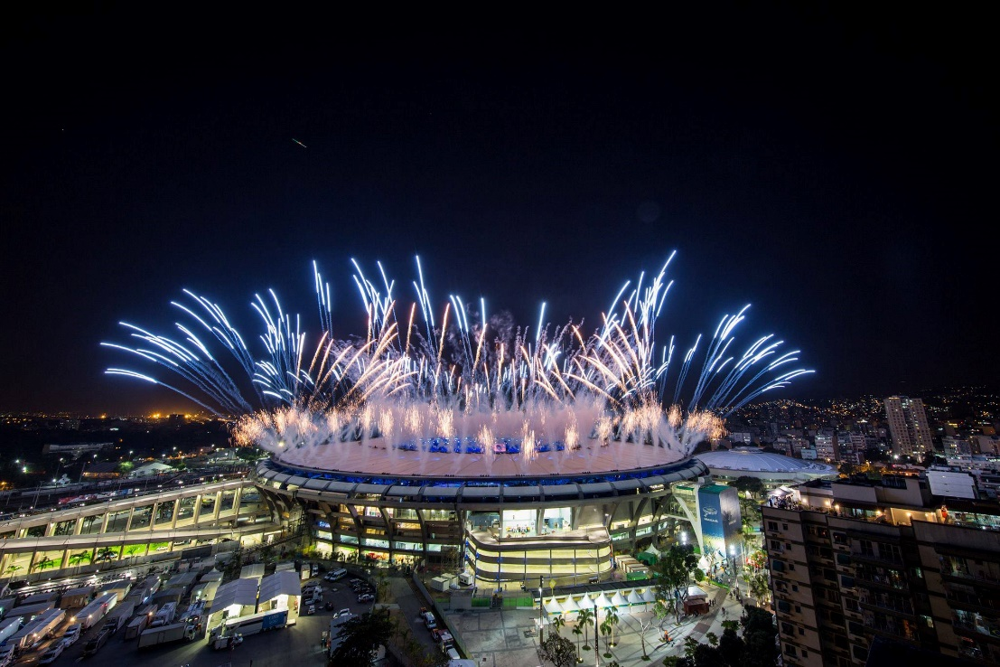
The principle of Motivation
When people are interested, they can be very passionate
²⁰ Next to him, Baruch son of Zabbai zealously repaired another section…
“Zealously”
It’s amazing what is possible when a group of people are focused on and organised toward achieving one goal
Notes:
Do you think this principle works today? You bet! Who are we most motivated to pray for? What missionaries do we tend to support financially? What country have we got a bigger burden for? What types of people do we most want to reach? The answer in many cases. Those we know. Those we have personal experience of. Those we are invested in.
When people are interested …
Verse 20 …
This word “zealously” usually means “to burn with anger.” It’s the type of intense anger the Lord displayed when the Israelites worshiped the golden calf instead of their the One who had brought them out of Egypt by his mighty power and outstretched arm. Now, Baruch was not angrily repairing a section. He had a powerful passion to see God’s city renewed and his glory revealed.
My favourite part of the Olympic Games is the Opening Ceremony. Frankly, it’s the main part I watch. I love seeing what a mere billion dollars and a several thousand people can accomplish when a deadline is looming and half the world is watching! They are indeed a showcase of talent, culture and big fat egos. But they also give us a glimpse into …
what is possible …

Slide 8
The most important thing
How do we know Nehemiah valued the people?
Because he wrote down their names
Whakapapa
What is the most important thing?
Notes:
How do we know Nehemiah valued the people?
Because he wrote …
Whakapapa: For the Jew, then and now, names means family means history means identity. Many kiwis can barely name our great-grandparents. But for many cultures, such as the Maori, their whakapapa, their lineage, is part of their identity.
Nehemiah gives us some excellent principles for setting and achieving remarkable targets. But it was his ability to lead the people so successfully that makes him stand out as a leader.
What is the most important thing?
He tangata. He tangata. He tangata. It’s People. It’s People. It’s People.

Slide 9
The Church
BOPSA: a Bunch Of People Sitting Around; or a
POPTART: Purposeful, Organised People Together Achieving Remarkable Targets?
Underlying everything we do there is passion for His glory, vision for his kingdom and reliance on his Spirit. He is the One we serve. He is the One we love above any other. As we love and serve him, we are being who he created us to be, we are fulfilling our purpose. Frankly, anything else is just boring!
Notes:
The church is the people of God. When you look at us, it may not seem all that spectacular. We may at times look like a BOPSA … Hopefully we will also look like a POPTART …
God’s presence may not seem that obvious at first glance – just like in Nehemiah 3. But underlying everything we do …

Slide 10
Questions to Ponder
What upsets you about the state of the community / world?
What is your attitude to money and the church?
What is the ultimate purpose of moving to 25 Union St?
Are we a BOPSA or a POPTART?

